Slide 1



Jump Start your automation skills for WVD
Freek Berson
Remoting Windows Enthusiast
@fberson
MVP since 2011
github.com/fberson

Slide 2

“We’ve seen two years’ worth of digital transformation in two months”

Slide 3
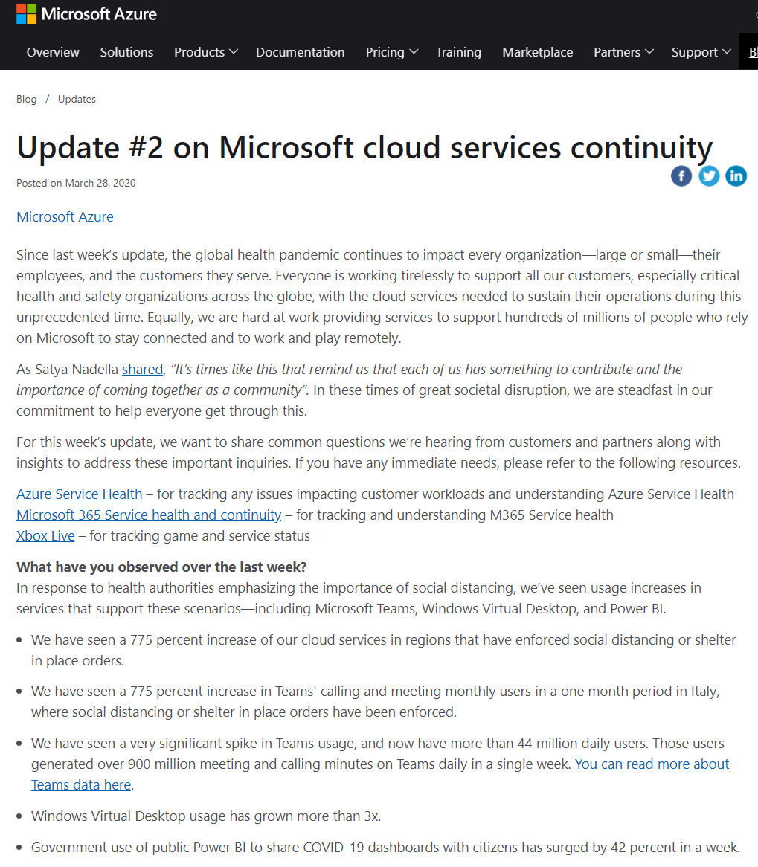
“Windows Virtual Desktop usage has grown more than 3x!”

Slide 4

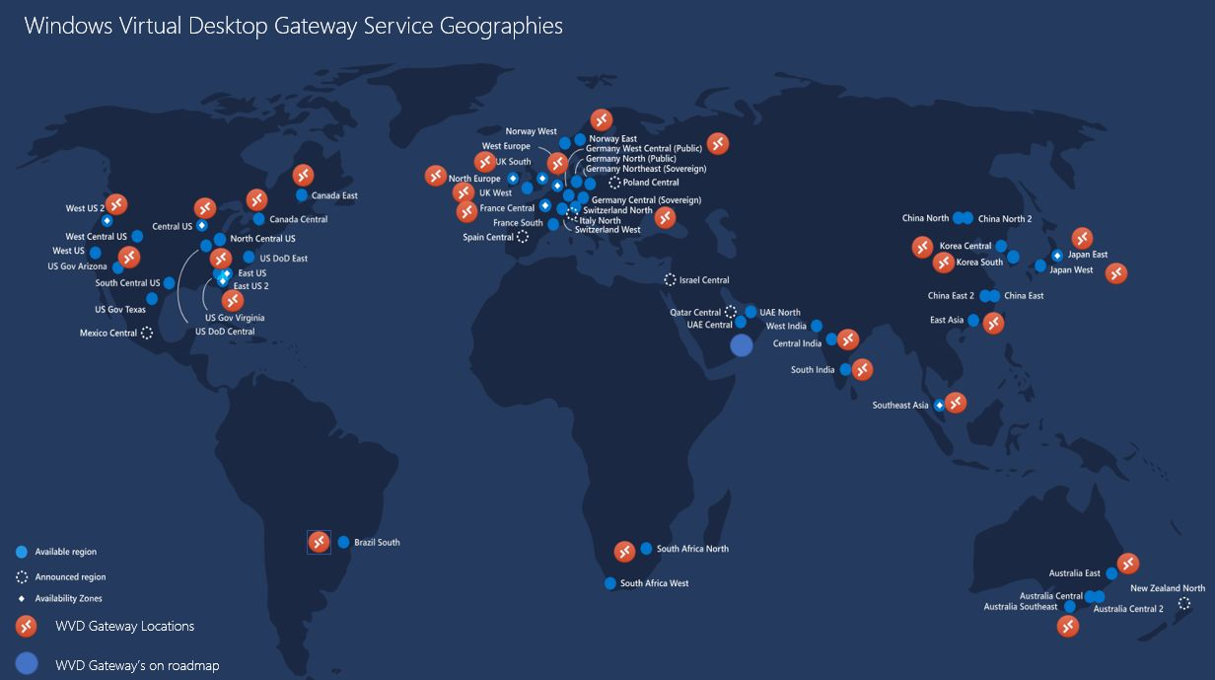



Windows Virtual Desktop
Provide a full-desktop, authenticated experience for users at every level
Reduce the costs and time spent
managing on-premises infrastructure
Simplify management, provisioning,
and access to corporate data and apps
Deploy and scale in minutes

Slide 5




Your subscription—your control
Architecture
Desktops and remote apps
Management and policies
Image, app, and profile management
Full Desktop
RemoteApp
User density, VM sizing, and scaling policies
Windows 10 Enterprise multi-session
Provides virtualization infrastructure as a managed service
Utilizes Azure Active Directory identity management service
Deploy and manage VMs in Azure subscription
Manage using existing tools like System Center Configuration Manager
Simply connect to on-premises resources - (VPN – ExpressRoute)
Windows 10 Enterprise
User management and identity
Windows Server
2012 R2 and newer
Windows 7 Enterprise
Full Desktop
Networking policies
Managed by Microsoft
Windows Virtual Desktop Service
Clients
Diagnostics
Gateway
Management
Broker
Load balancing
Infrastructure
Compute
Storage
Networking

Slide 6
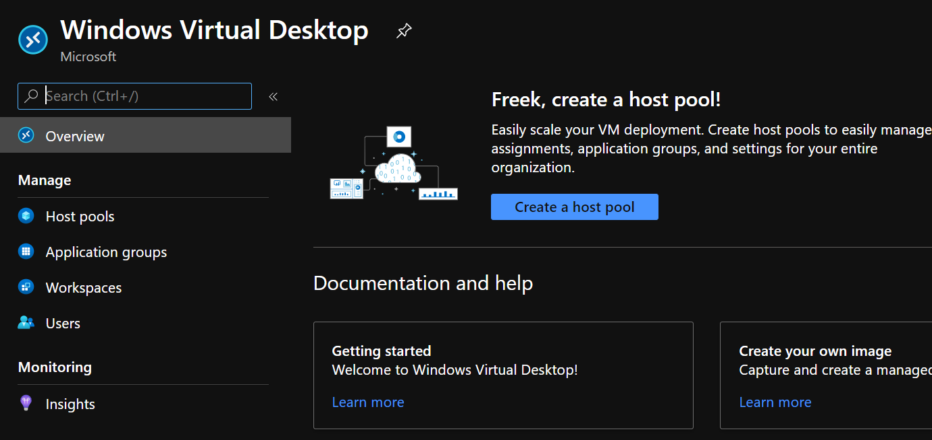
Deployment

Slide 7
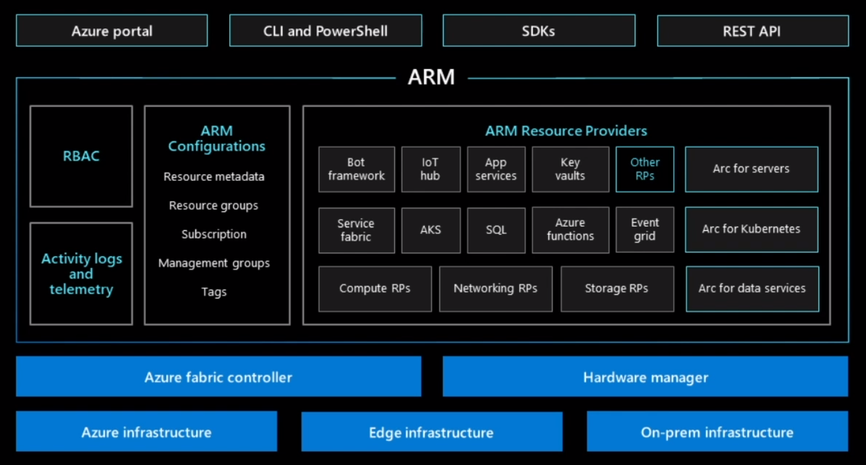
Azure Resource Manager

Slide 8
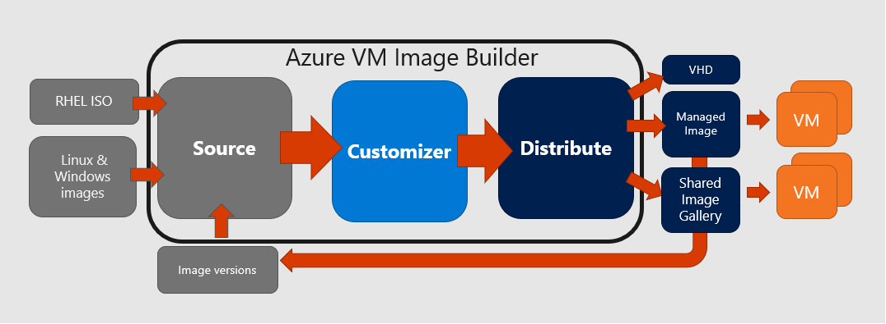
Azure Image Builder

Slide 9
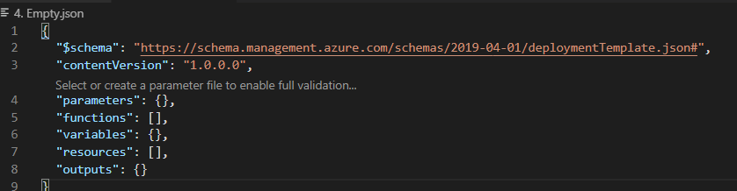
Infrastructure as code
Language Azure Resource Manager accepts JavaScript Object Notation (JSON) templates that comply with a JSON schema. JSON is an industry standard, human readable language.
Tooling Although it is possible to create a template for a complete application in simple text editor, there is sophisticated tooling available that provides you with a better authoring experience for Azure Resource Manager templates.

Slide 10
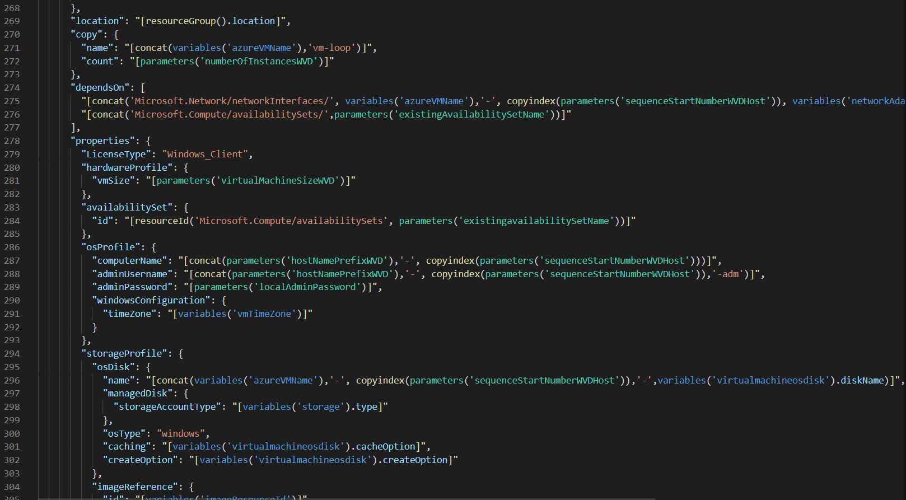
JSON challenges

Slide 11

Project ‘Bicep’
"..Bicep is a Domain Specific Language (DSL) for deploying Azure resources declaratively. It aims to drastically simplify the authoring experience with a cleaner syntax and better support for modularity and code re-use. Bicep is a transparent abstraction over ARM and ARM templates.

Slide 12
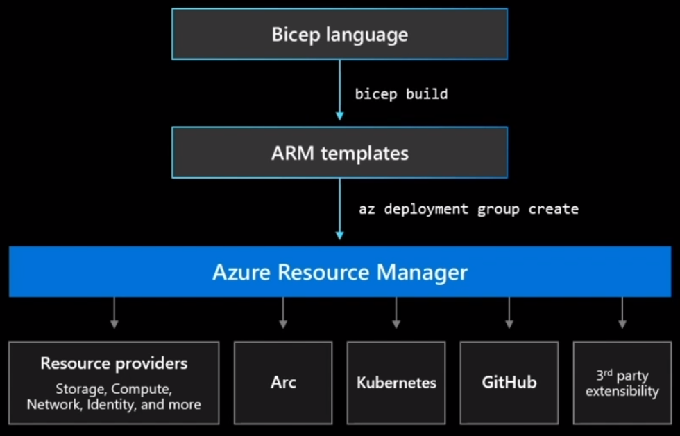
Project ‘Bicep’
Simple declarative language to provision infrastructure to Azure.
Intuitive
Easy to read and to author
Transpiles to ARM Templates Leverage ARM template knowledge and investments Modular
Abstract common blocks of code into reusable parts
Open Source
Transparency and community

Slide 13
Installing
1. Install the Bicep CLI (required)
# Create the install folder
$installPath = "$env:USERPROFILE\.bicep"
$installDir = New-Item -ItemType Directory -Path $installPath -Force
$installDir.Attributes += 'Hidden'
# Fetch the latest Bicep CLI binary
(New-Object Net.WebClient).DownloadFile("https://github.com/Azure/bicep/releases/latest/download/bicep-win-x64.exe", "$installPath\bicep.exe")
# Add bicep to your PATH
$currentPath = (Get-Item -path "HKCU:\Environment" ).GetValue('Path', '', 'DoNotExpandEnvironmentNames')
if (-not $currentPath.Contains("%USERPROFILE%\.bicep")) { setx PATH ($currentPath + ";%USERPROFILE%\.bicep") }
if (-not $env:path.Contains($installPath)) { $env:path += ";$installPath" }
# Verify you can now access the 'bicep' command.
bicep --help
# Done!
2. Install the Bicep VS Code extension(optional)
# Fetch the latest Bicep VSCode extension
$vsixPath = "$env:TEMP\vscode-bicep.vsix"
(New-Object Net.WebClient).DownloadFile("https://github.com/Azure/bicep/releases/latest/download/vscode-bicep.vsix", $vsixPath)
# Install the extension
code --install-extension $vsixPath
# Clean up the file
Remove-Item $vsixPath
# Done!

Slide 14
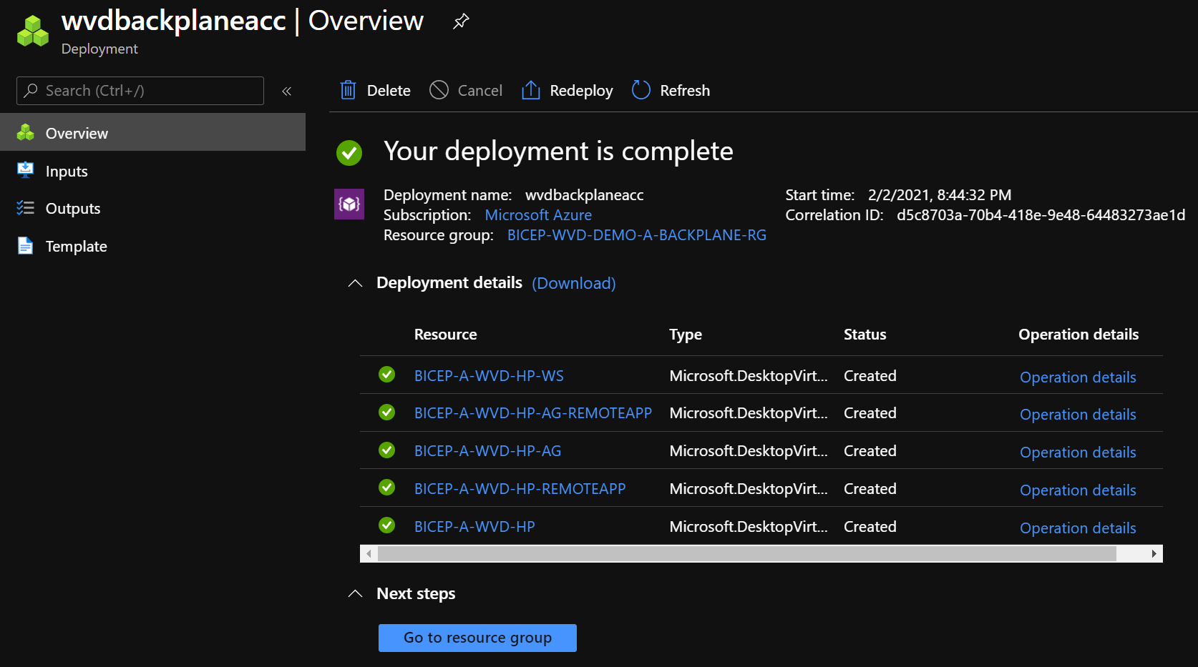
Demo

Slide 15
Bicep Road map
Current release: CLI version 0.2.328
~90% of ARM template capabilities implemented!
V0.3 (Feb/March)
- Loops
- Conditionals
- Decompiler
- Production usage
V0.2 (Oct/Nov)
- VSCode Intellisense
- Support for modules
V0.1
Alpha Release available on August 31st

Slide 16

Modules & reusing your code

Slide 17
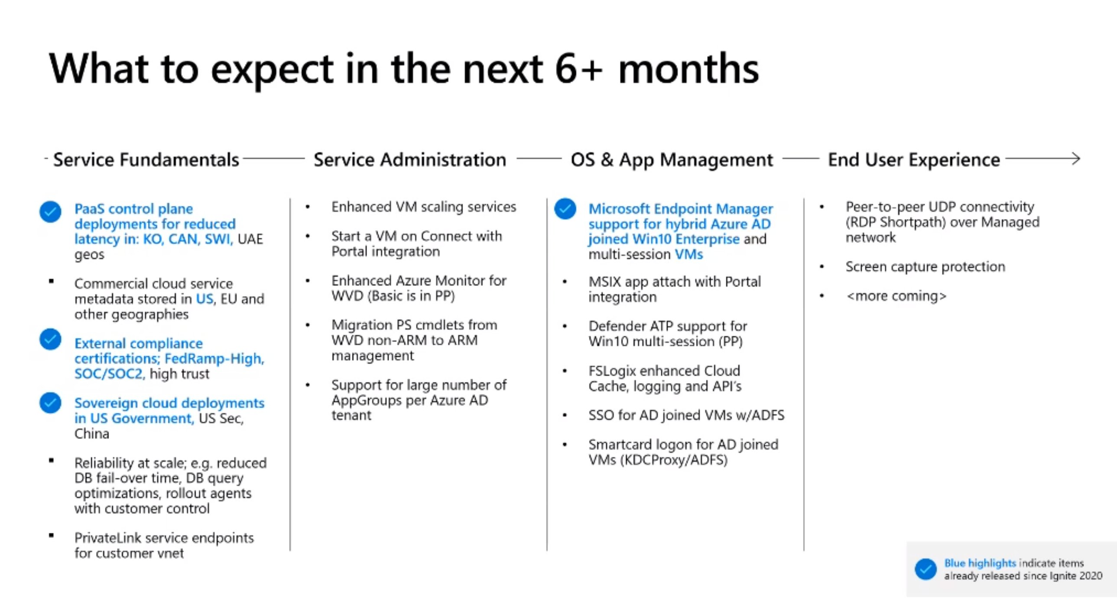
Road map Windows Virtual Desktop

Slide 18
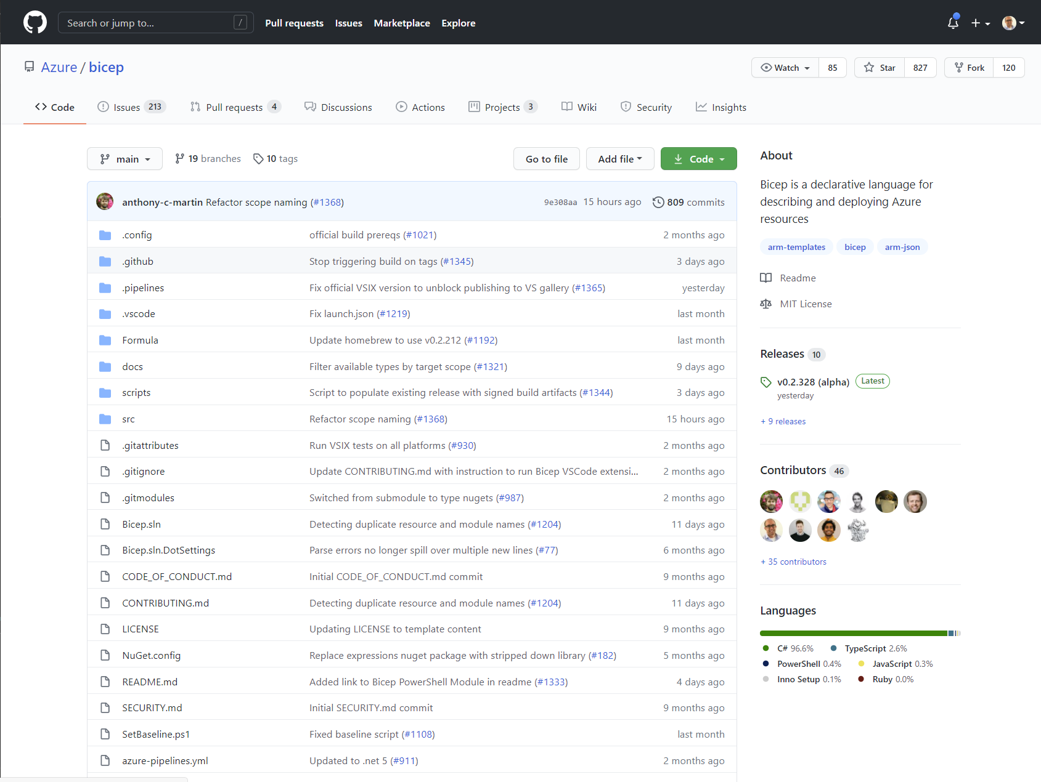
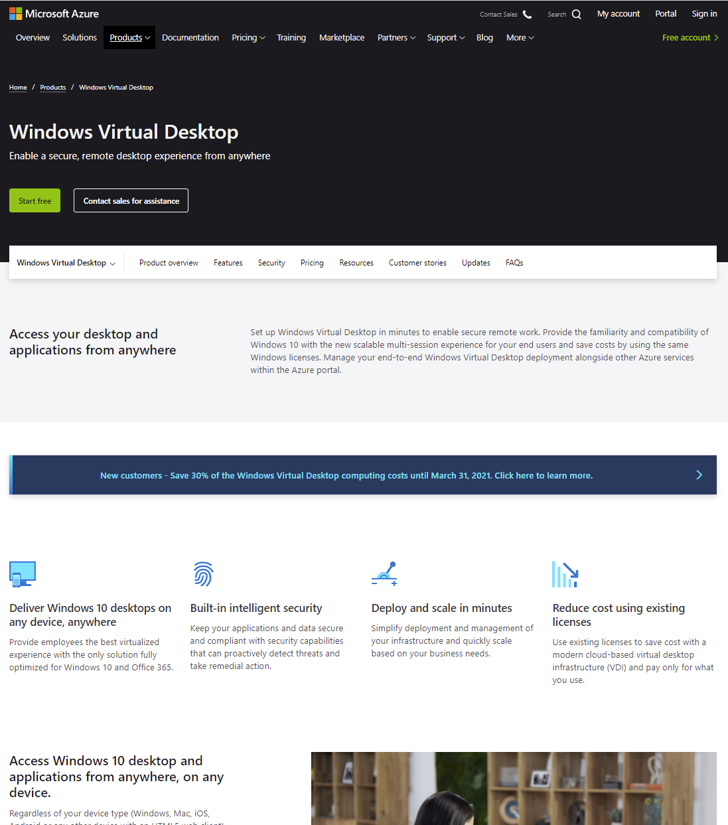
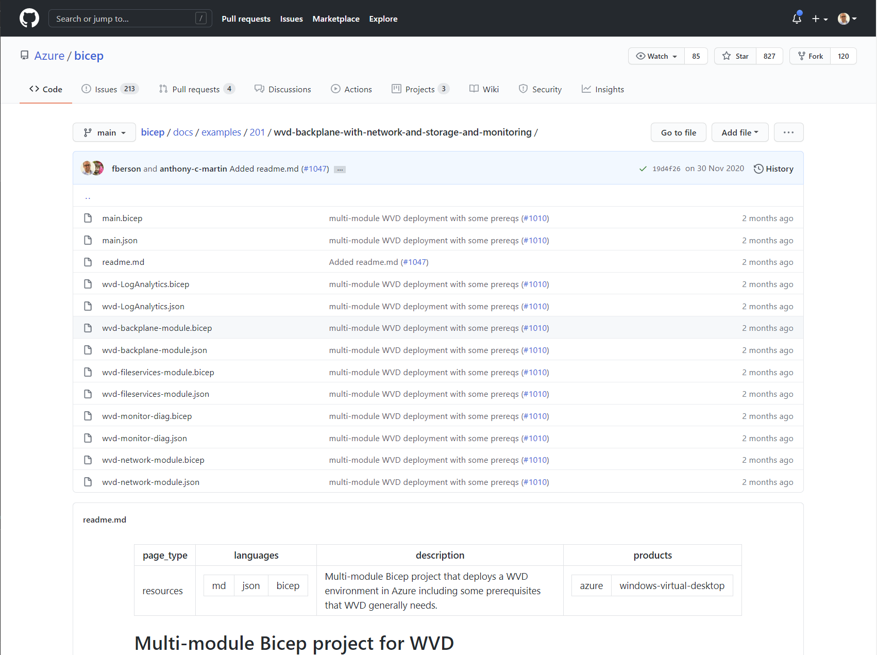
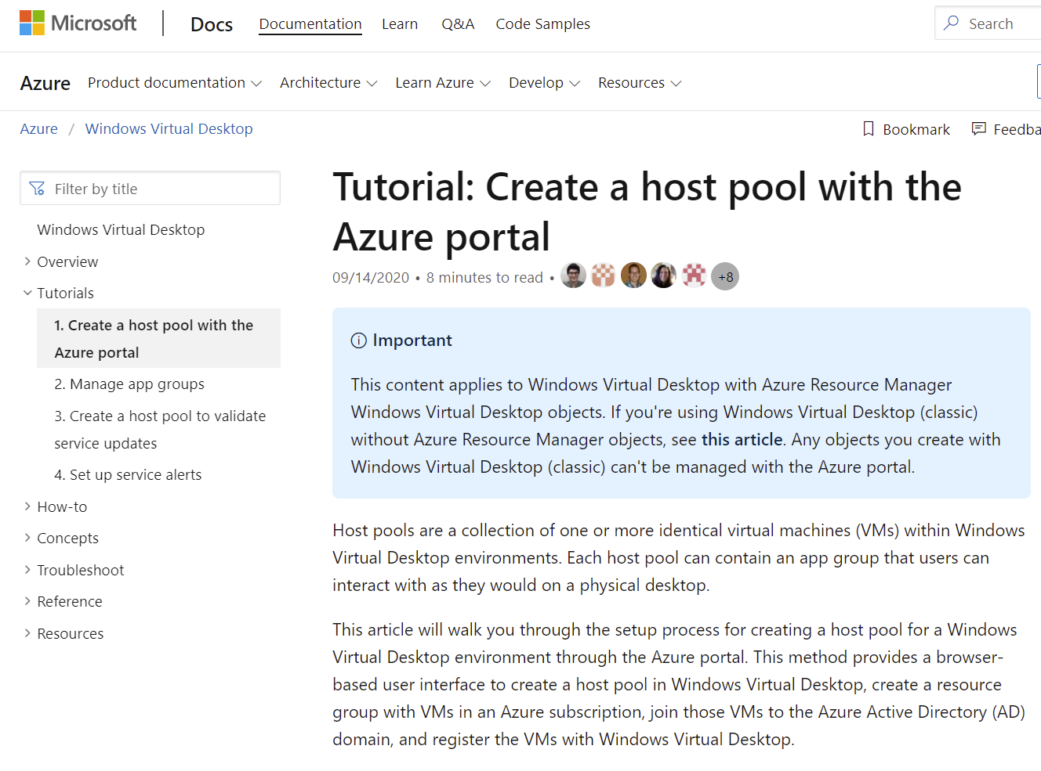
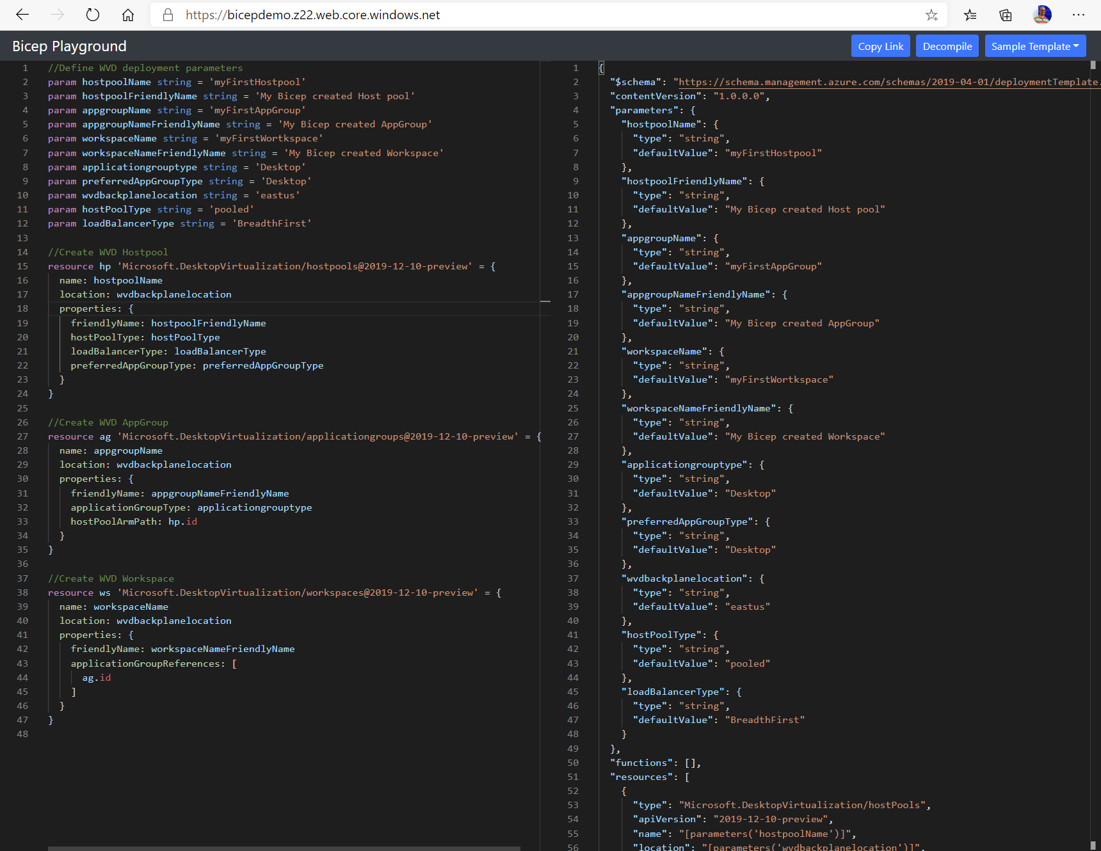
Call to actions:
aka.ms/bicep
aka.ms/wvd
Install guides, tutorials, example code & playgrounds!
Docs pages with all WVD info

Slide 19

Thank you!
Feedback:
Freek Berson
@fberson
github.com/fberson

